Slide 1

OUTREACH INTERNATIONAL MEDIA LIMITED
OUT OF HOME ADVERTISING PLATFORMS PORTFOLIO
www.outreachmedialtd.net| i n f o @ outreachmedialtd.net| 08092222091; 08037865256

Slide 2
COMPANY PROFILE

Slide 3

“At Outreach, we out stand others !
www.outreachmedialtd.net| i n f o @ outreachmedialtd.net| 08092222091; 08037865256

Slide 4
CORPORATE OVERVIEW
NAME: OUTREACH INTERNATIONAL MEDIA LIMITED
HEADQUARTERS: 1,Ali Yakassai Street off Alu Avenue(Umar Faruk
Villa)Nassarawa GRA, Kano.
LAGOS OFFICE: 2, Atinuke Olabanjo Street, Ikeja,Lagos state.
TELEPHONE: 234-8092222091, 08037865256
YEAR OF ESTABLISHMENT: 2002
www.outreachmedialtd.net| i n f o @ outreachmedialtd.net| 08092222091; 08037865256

Slide 5
ABOUT US
Outreach International Media Limited is an indigenous company based in Nigeria and registered under the Companies And Allied Matter Act (CAMA) with registration number;RC460185. Our Prestigious Organization is a registered member of the Advertising Regulatory Council Of Nigeria (ARCON) with membership Number; 032 and also a registered member of the Out of Home Advertising Association Of Nigeria(OAAN) with membership number;067. We specialize in developing innovative ways to assist our clients to grow their products, improve their brand while at the same time reaching their proposed target markets. Our main objective is to ensure that your organization achieves its set advertising goals through the usage of multiple outdoor channels.
Regardless of the preferred platform chosen for advertising, Outreach Media will provide the most competitive rates and expertise in the industry as well as ensuring that jobs are carried out by the highest performing teams with the appropriate skill set.
From inception until now, Outreach International Media Limited has successfully built and maintained the best working relationship with all local stakeholders e.g. land owners and government authorities to ensure the smooth run of all our campaigns.
www.outreachmedialtd.net| i n f o @ outreachmedialtd.net| 08092222091; 08037865256

Slide 6
OUR MISSION
To reach out to the desired target consumers in the market place for an effective creation of brand awareness, visibility, acceptability and patronage of our numerous clientele products and services
OUR VISION
To be a strong player within the elites of OOH advertising practitioners in Nigeria and the international space.

Slide 7

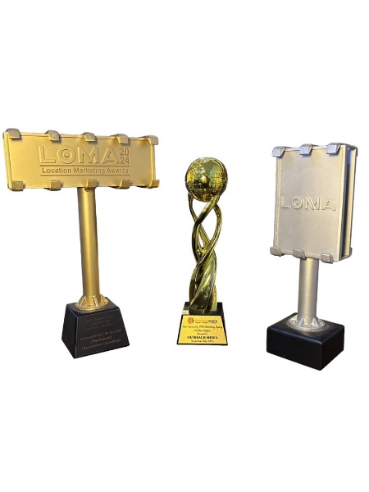

AWARDS
Most Outstandung OOH Advertising Agency (NORTH Region)
Agile in static OOH implementation 2023
Outstanding OOH campaign for financial service

Slide 8
OUR TEAM
Our Team comprises of highly trained, talented and experienced professionals who are
committed to rendering bespoke services.
Presently, the Company has a staff strength of Fourty six (46)
We have professionals who are specialists from various field of works, which includes; Engineering, Marketing, Accounting , Public Relations, Information Technology, Envoronmental Beautifications etc, this therefore provides the company with a veritable pool of skills and potentials needed for the quality services which our name has grown to become synonymous with.

Slide 9
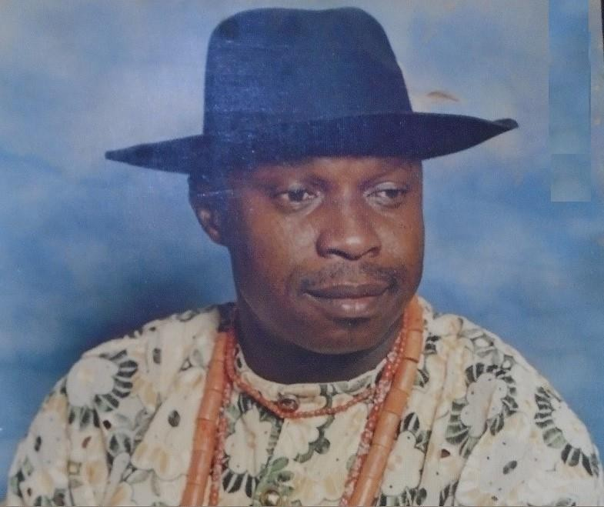
PERSONNEL
Late Mr. Moses Orife is the Founder of the Company.
He studied marketing at the National School of Salesmanship, Manchester, England, where he obtained a Diploma in sales Marketing and Management.
He is an Associate member of Nigerian Institute of Public Relations and also a full member of APCON and OOAN
After working in various capacities in a number of organisations, he started Outreach International Media Limited in 2002 as the founder and pioneer Chief Executive Officer. He has nurtured the company from then to the enviable position it currently occupies in the advertising landscape.
Late Mr. Moses Orife FOUNDER
Mr. Orife is an astute business executive with interest in Advertising, Agro-industry, Oil and Gas, Banking, Real Estate, Telecommunications, etc.

Slide 10
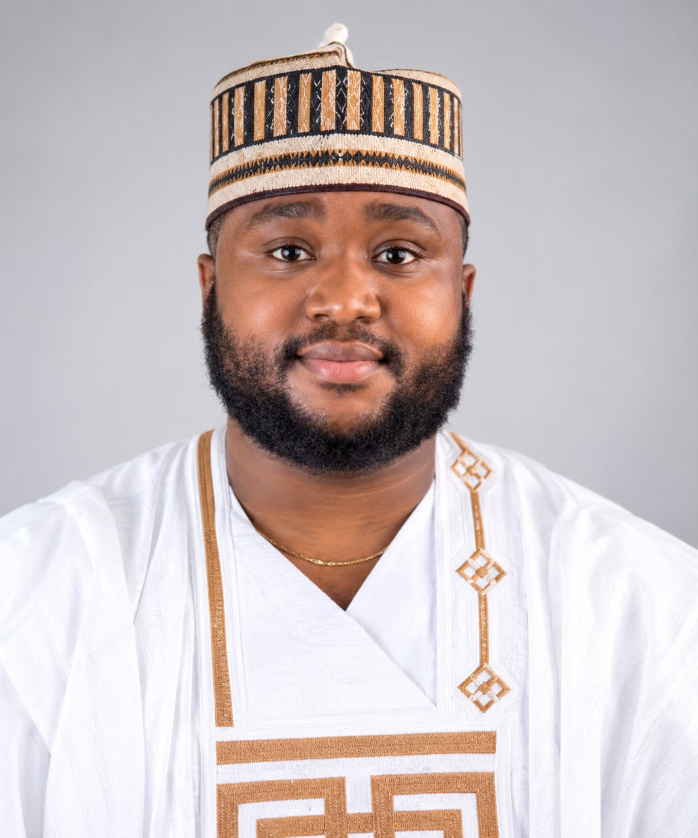
PERSONNEL
Mr. Darlington Orife is a visionary and result-driven leader with a solid academic foundation in Accounting and International
Business.
He holds a B.Sc. in Accounting from Benson Idahosa University, Benin City, Edo State (2012), and an MBA in International Business from Birmingham City University, United Kingdom (2015).
As a dedicated professional, Mr. Darlington Orife is an Associate Member of the Advertising Regulatory Council of Nigeria (ARCON), the Nigerian Institute of Management (NIM), and the Institute of Strategic Management (ISM).
He began his journey with Outreach International Media Limited in 2014 as Finance Controller, where he demonstrated exceptional leadership and financial acumen.
In 2020, he assumed the role of Managing Director/Chief Executive Officer, succeeding the late Mr. Moses Orife.
Under his leadership, Outreach International Media Limited has continued to evolve, achieving greater operational efficiency, strategic expansion, and a renewed commitment to innovation and excellence.
Mr. Darlington Orife’s forward-thinking approach, passion for growth, and unwavering integrity continue to inspire the entire organization toward sustained success.
Mr. Darlington Orife
MD/CEO

Slide 11
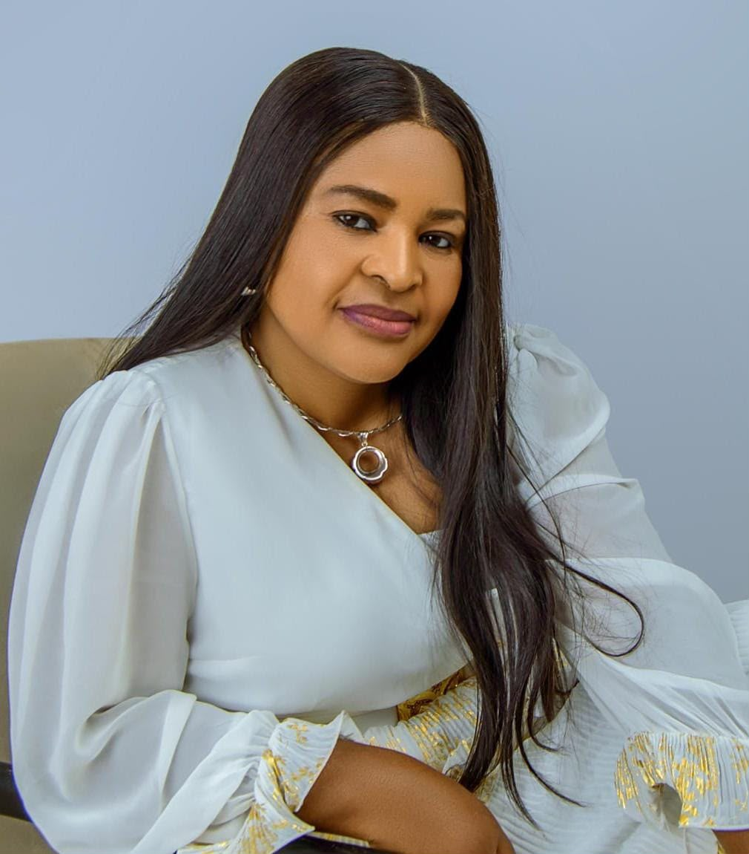
PERSONNEL
Mrs. Ifeoma Uche is the General Manager of Outreach and holds a Master’s Degree in Public Policy & Administration from Bayero University, Kano.
She is an Associate Member of the Advertising Regulation Council of Nigeria (ARCON) and brings extensive experience in administration, advertising, and business management.
Before joining Outreach in September 2010, she worked with Godwin Obakpolor Estate Surveyors and Valuers from 2004 to 2010 as an Estate Officer.
Mrs. Uche is also a Peace Ambassador, an honour conferred on her by the **African Youth Assembly for Peace**, in recognition of her commitment to promoting peace and positive change.
She was also recognized by Christ Embassy (LoveWorld Incorporated) as the Most Impactful Change Maker in Kano, in recognition of her positive impact and contribution to the community.
Mrs. Ifeoma Uche Manager Kano

Slide 12
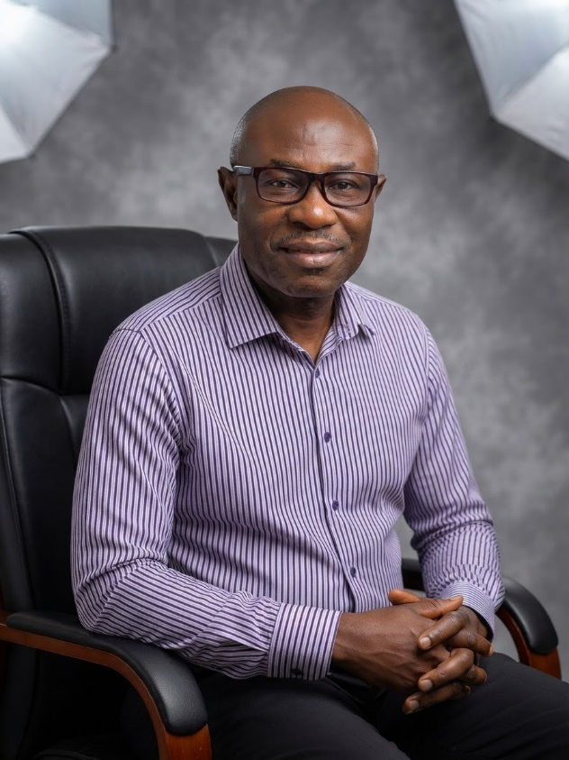
PERSONNEL
Mr. Mike Orife is the General Manager; Admin and Operations for Outreach International Media Limited’s Lagos office, bringing a wealth of technical knowledge and operational expertise to the role.
He earned his B.Sc. in Electronics and Computer Engineering from Lagos State University (LASU) in 1997.
Prior to joining Outreach International Media Limited in 2012, Mr. Mike Orife gained extensive experience in Information Technology, working with multiple organizations where he honed his skills in systems management, process optimization, and technical operations.
Since joining Outreach, he has been instrumental in streamlining operational processes, enhancing efficiency, and ensuring seamless execution of projects across the South West, South South, and South East. Mr. Mike Orife’s combination of technical proficiency, leadership, and dedication continues to drive the company’s success in day-to-day operations.
Mr. Mike Orife General Manager – Admin & Operations

Slide 13
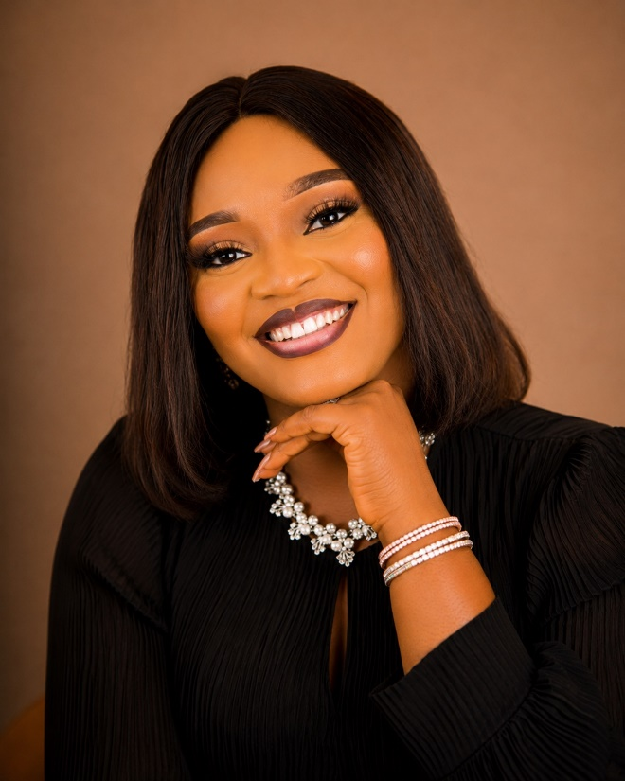
PERSONNEL
Mrs. Deborah Olanrewaju is a passionate and results-driven finance Personnel with a strong background in auditing and financial management.
She earned her Higher National Diploma (HND) from the esteemed Yaba College of Technology, Yaba, Lagos, in 2019.
Over the years, she has worked with several reputable auditing firms, where she developed a deep understanding of financial analysis, compliance, and audit processes.
In 2021, she brought her wealth of experience to Outreach International Media Limited, where she continues to contribute to the company’s financial integrity and operational growth.
Known for her dedication, attention to detail, and commitment to excellence, Mrs. Olanrewaju is driven by a passion for continuous improvement and professional integrity in all her endeavors.
Mrs. Deborah Olanrewaju Finance Controller

Slide 14
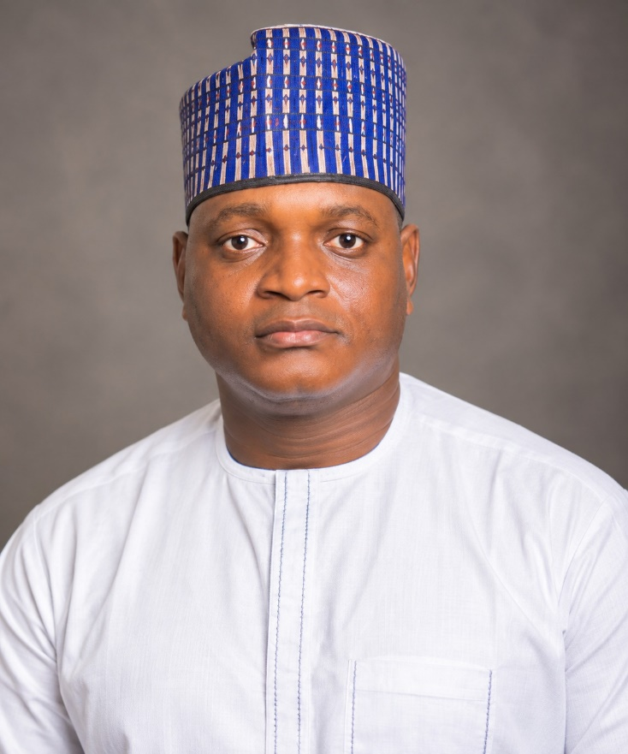
PERSONNEL
Mr. Dahiru Umar serves as the Business Development Executive for Outreach International Media Limited’s Kano Branch, bringing extensive experience in marketing and business growth.
He holds a Diploma in Marketing from Kano State Polytechnic.
Since joining the organization in 2003, Mr. Umar has played a key role in expanding client relationships, driving business development strategies, and supporting the company’s growth objectives. His dedication, insight, and commitment to excellence have made him a valuable member of the Outreach team.
Mr. Dahiru Umar
Executive- Business Development

Slide 15
PERSONNEL
Mr. Friday Roberts is responsible for overseeing the company’s day-to-day operations, coordinating field activities, managing operational processes, and ensuring projects are executed efficiently and within agreed timelines. He holds a School Leaving Certificate and has practical experience in operations management, field coordination, logistics, and team supervision.
Mr. Friday Robert
Head of Operaions.

Slide 16
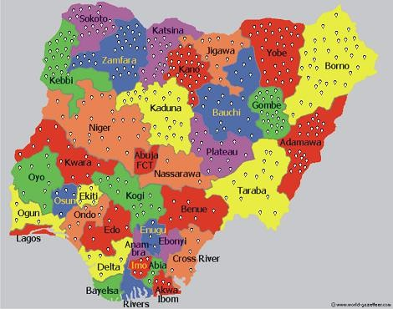
HOARDINGS DISTRIBUTION

Slide 17
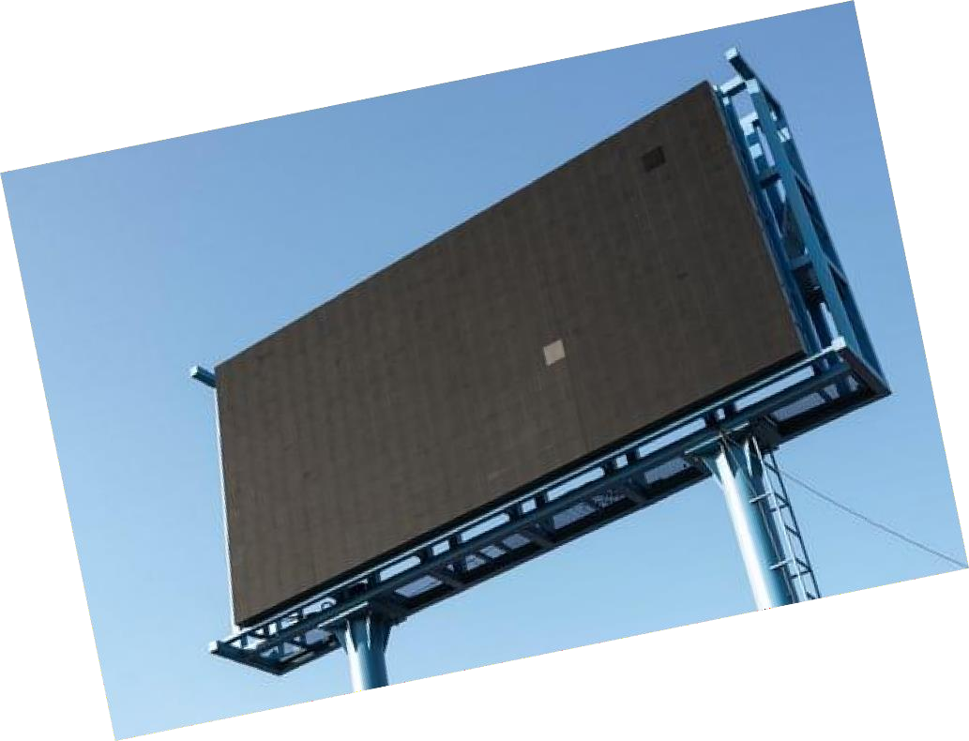


VALUE PROPOSITION
We deliver value in the following ways:
Multiple Platform Availability Competitive Pricing Structure Dedicated Staff
Advisory Services
Years Of Industry Experience
www.outreachmedialtd.net| i n f o @ outreachmedialtd.net| 08092222091; 08037865256

Slide 18
OUR PLATFORMS
We have a combination of platforms which are as follows:
Wall Branding Static Billboards
Building Branding Advertising KEKE Mobile Advertising Street Lamp Poles
www.outreachmedialtd.net| i n f o @ outreachmedialtd.net| 08092222091; 08037865256

Slide 19
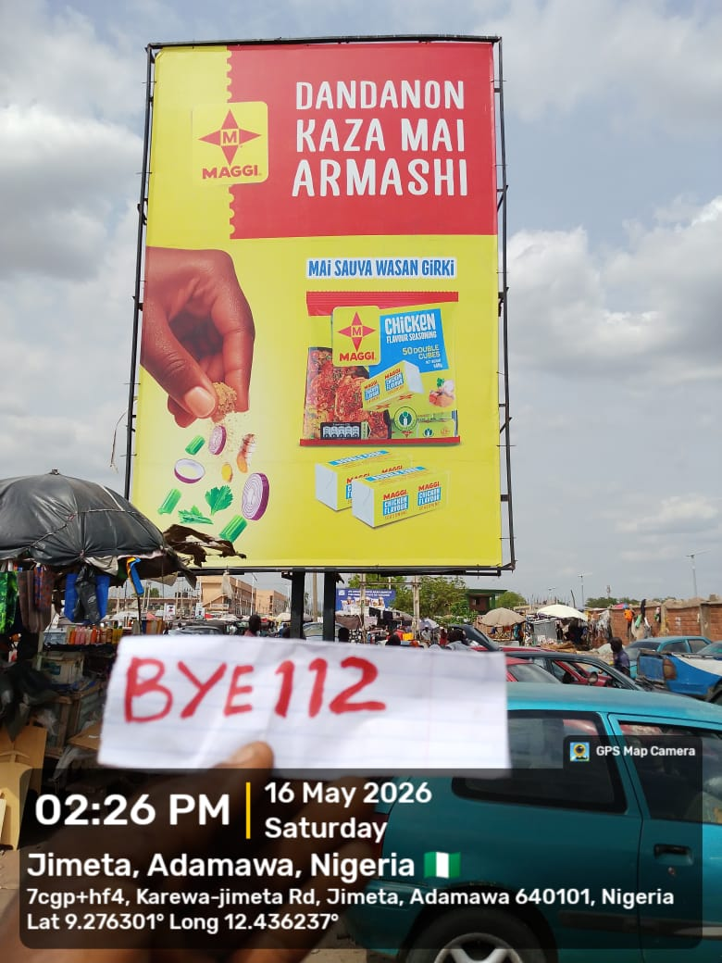
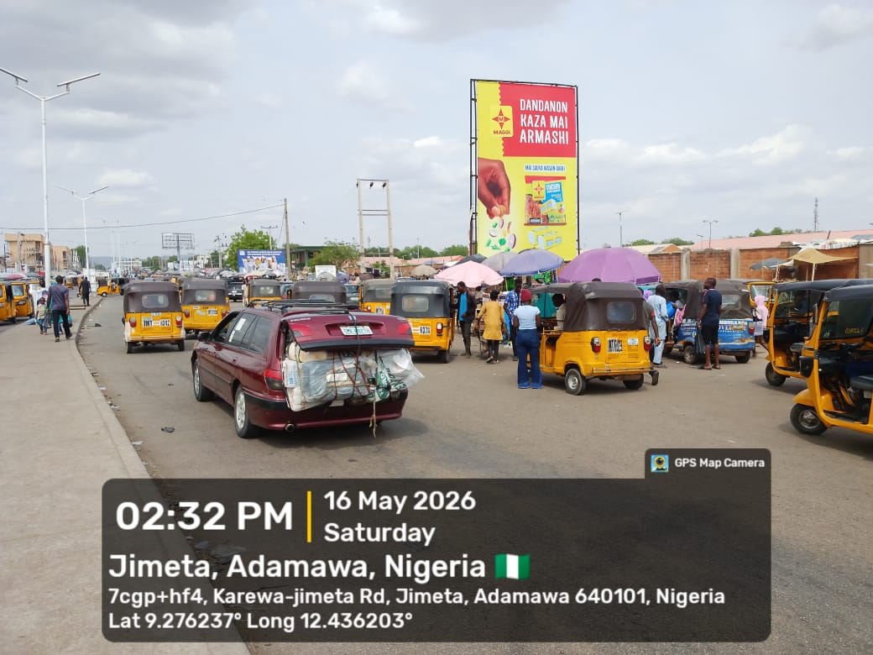
PORTRAIT
www.outreachmedialtd.net| i n f o @ outreachmedialtd.net| 08092222091; 08037865256

Slide 20
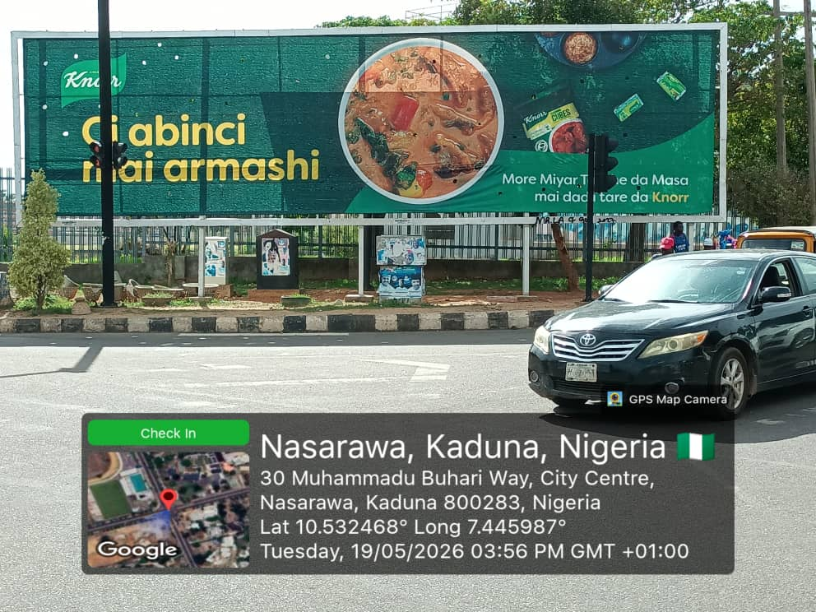
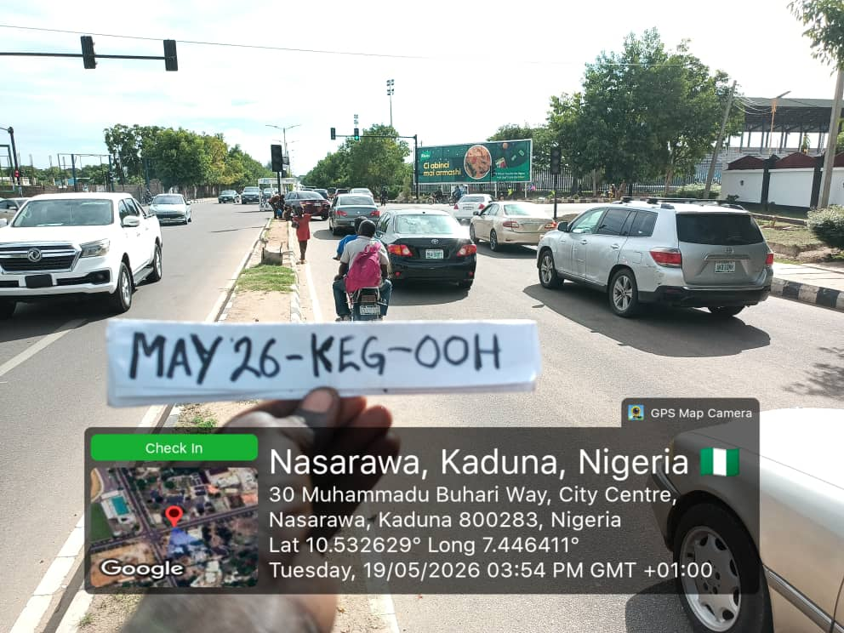
MEGA BOARD
www.outreachmedialtd.net| i n f o @ outreachmedialtd.net| 08092222091; 08037865256

Slide 21
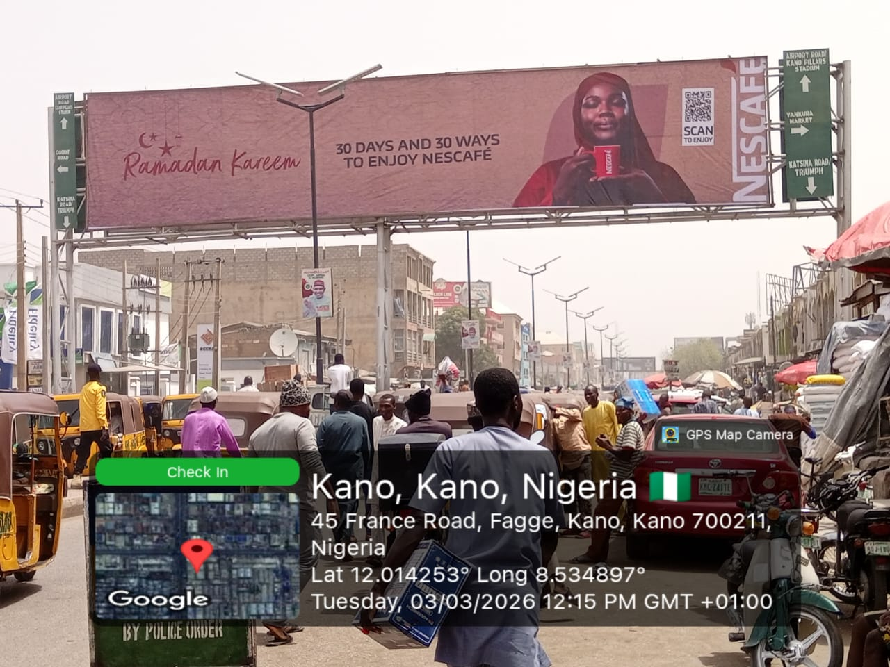
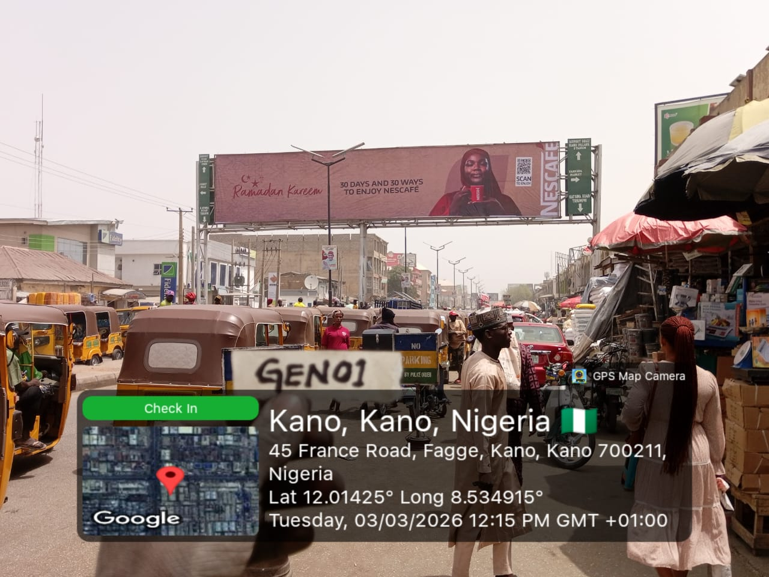
GANTRY
www.outreachmedialtd.net| i n f o @ outreachmedialtd.net| 08092222091; 08037865256

Slide 22
EYECATHER
www.outreachmedialtd.net| i n f o @ outreachmedialtd.net| 08092222091; 08037865256

Slide 23
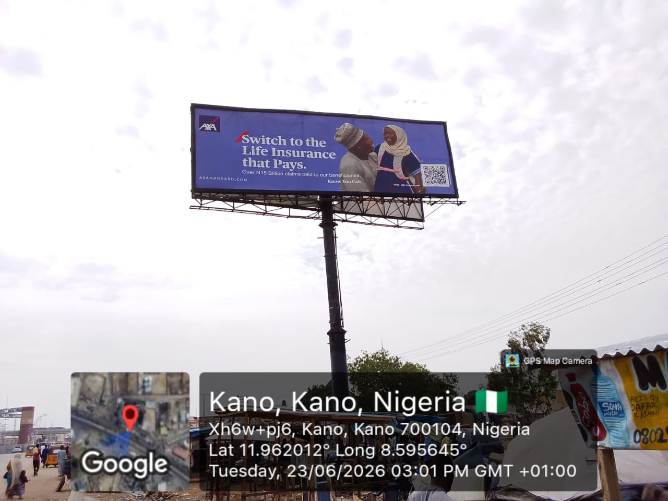
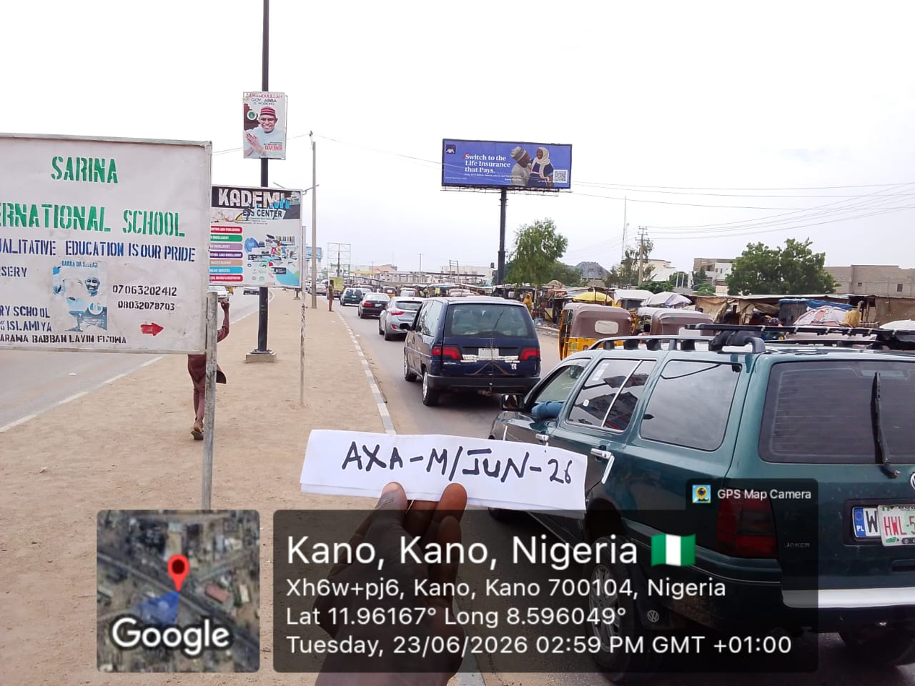
UNIPOLE
www.outreachmedialtd.net| i n f o @ outreachmedialtd.net| 08092222091; 08037865256

Slide 24
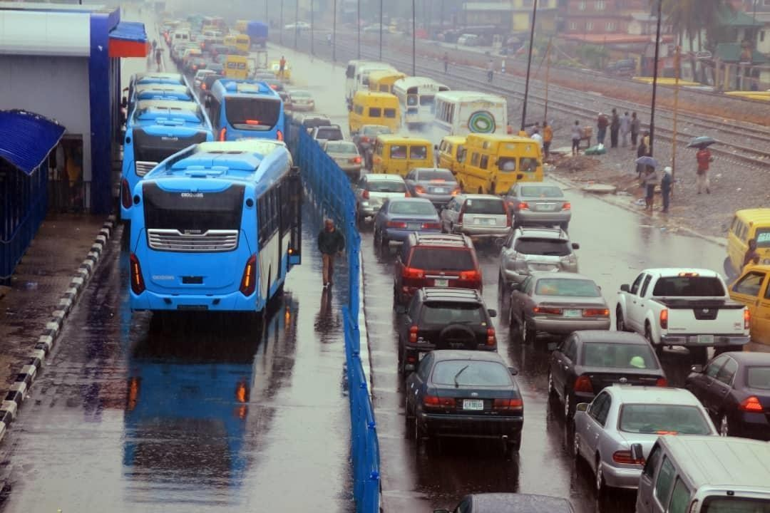
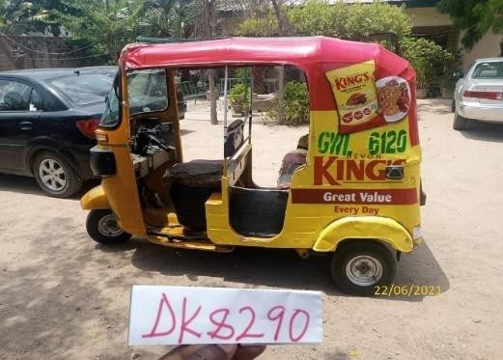
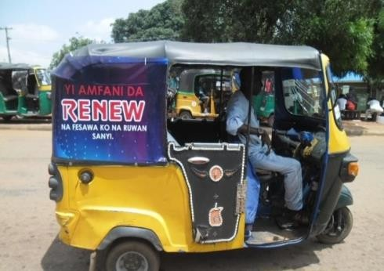
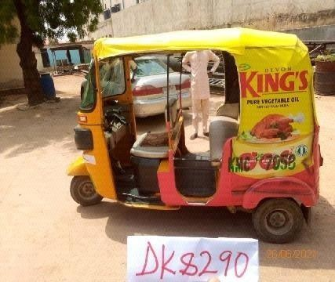
BRT BUS/ KEKE BRANDING
Bus Station on BRTCorridor
Keke Branding
www.outreachmedialtd.net| i n f o @ outreachmedialtd.net| 08092222091; 08037865256

Slide 25
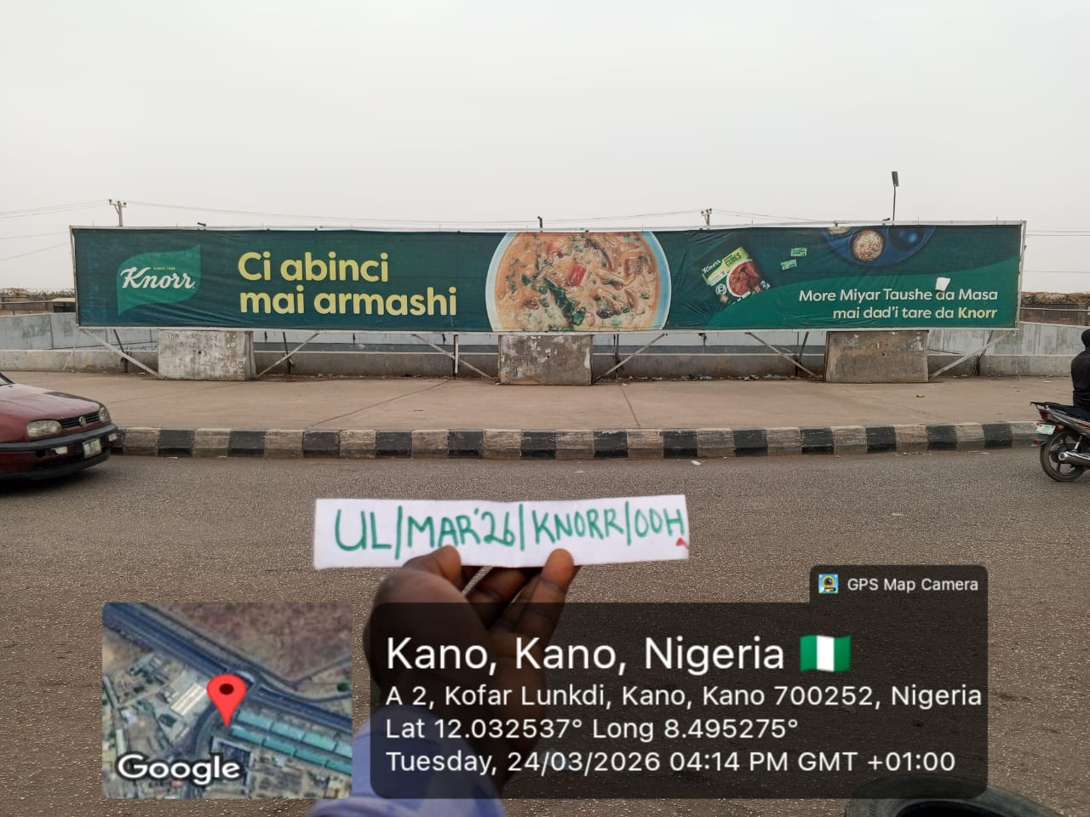
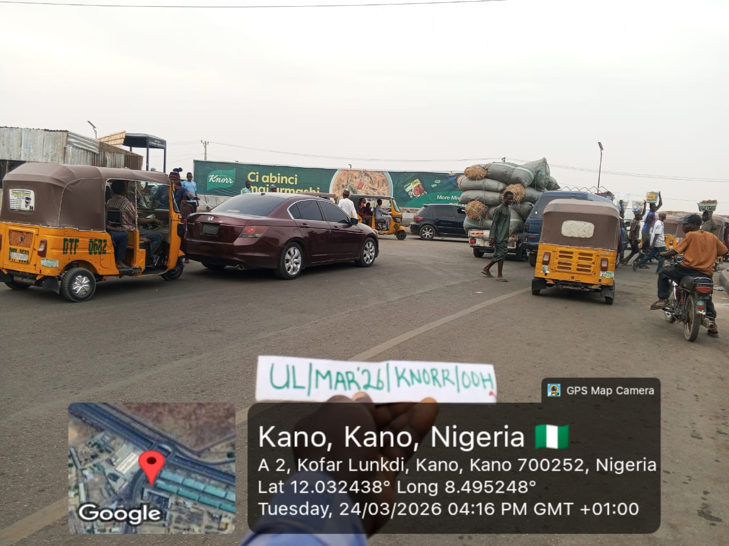
ROUNDABOUT PANEL
www.outreachmedialtd.net| i n f o @ outreachmedialtd.net| 08092222091; 08037865256

Slide 26
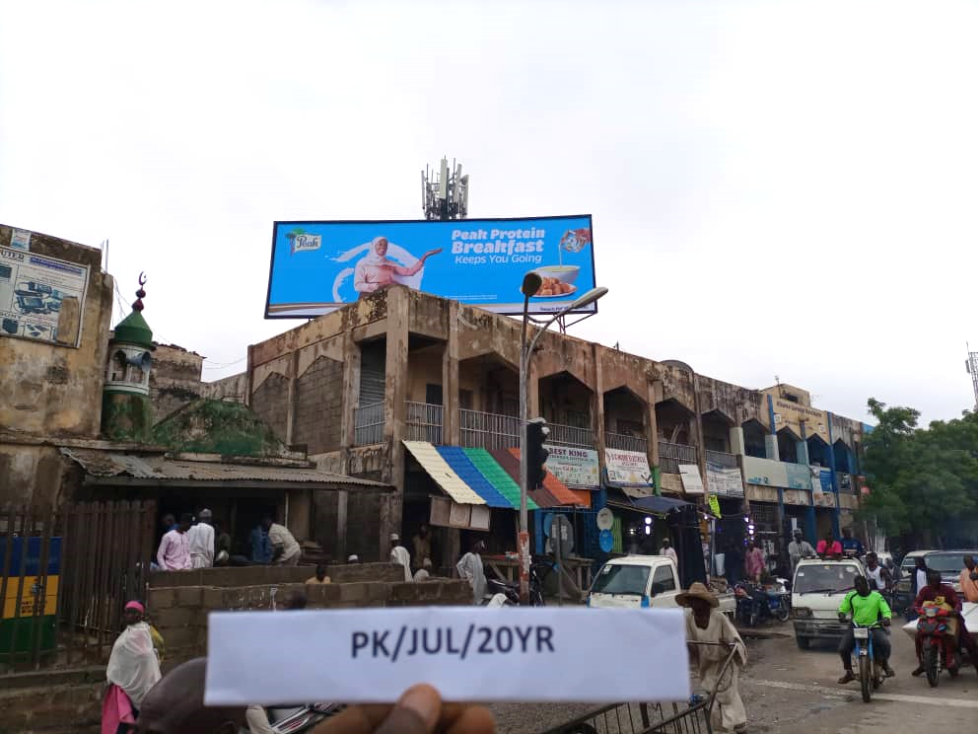
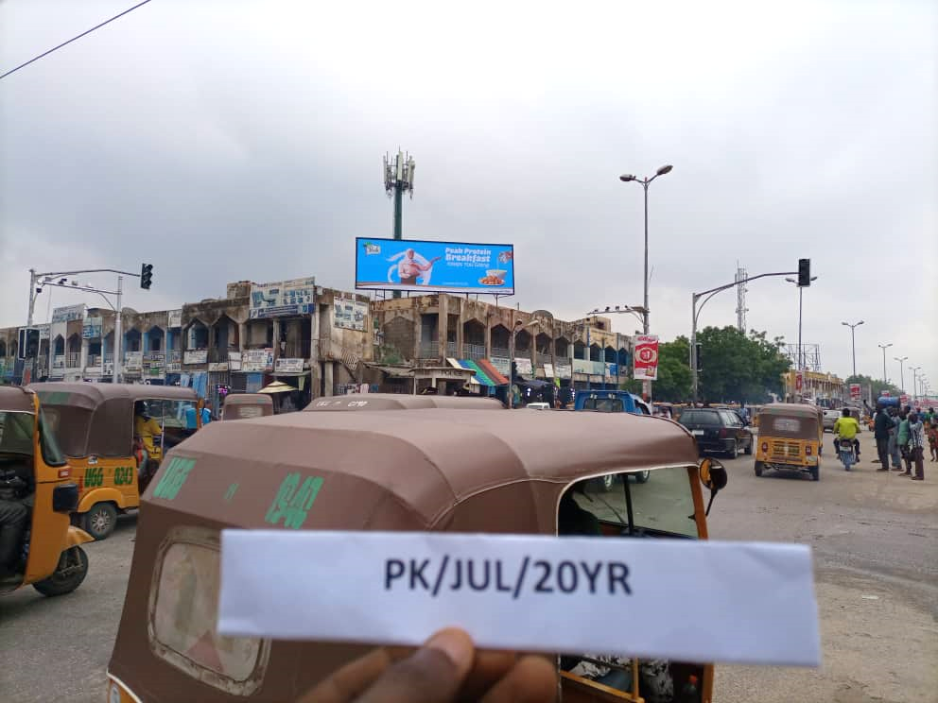
ROOFTOP
www.outreachmedialtd.net| i n f o @ outreachmedialtd.net| 08092222091; 08037865256

Slide 27
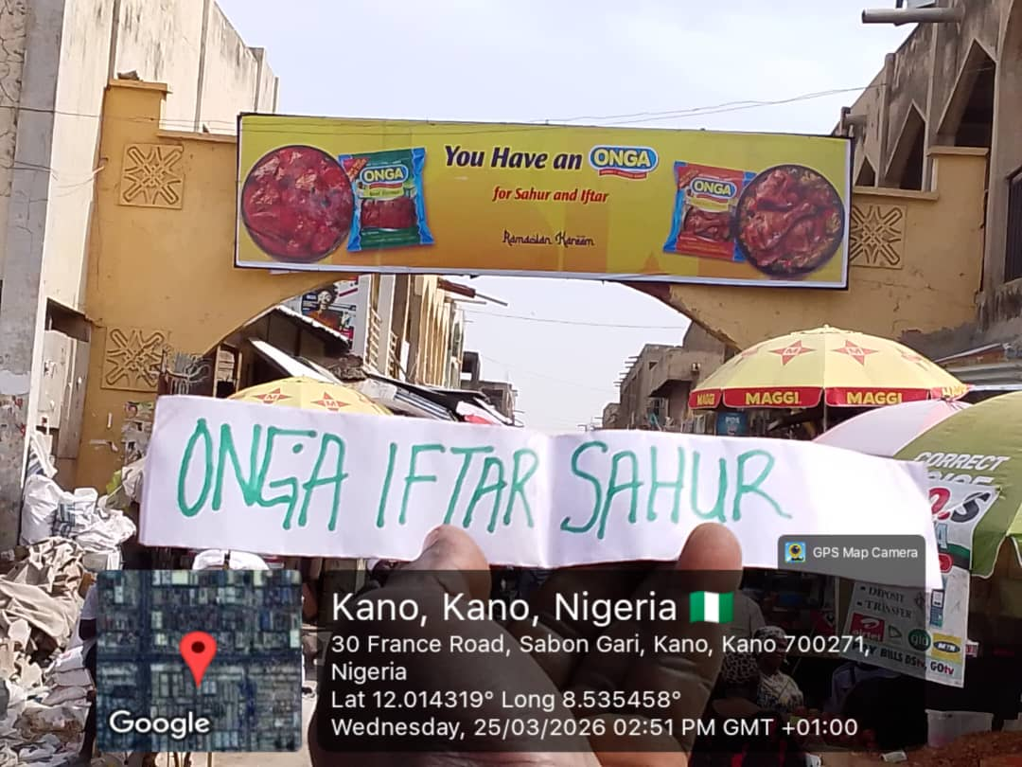
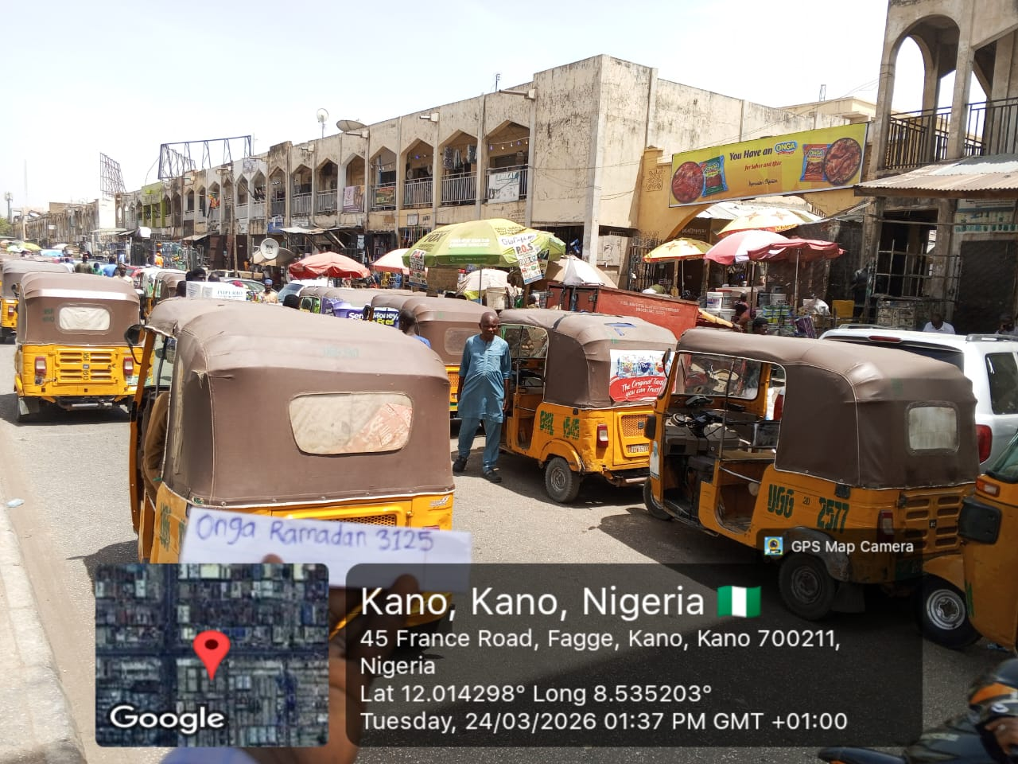
MARKET ARCADE
www.outreachmedialtd.net| i n f o @ outreachmedialtd.net| 08092222091; 08037865256

Slide 28
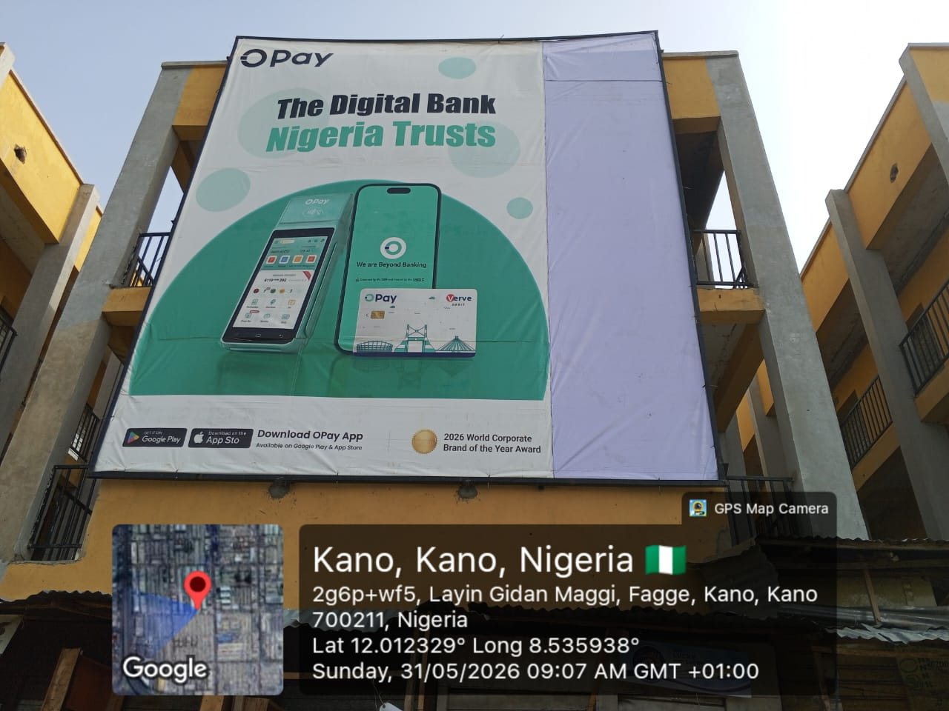
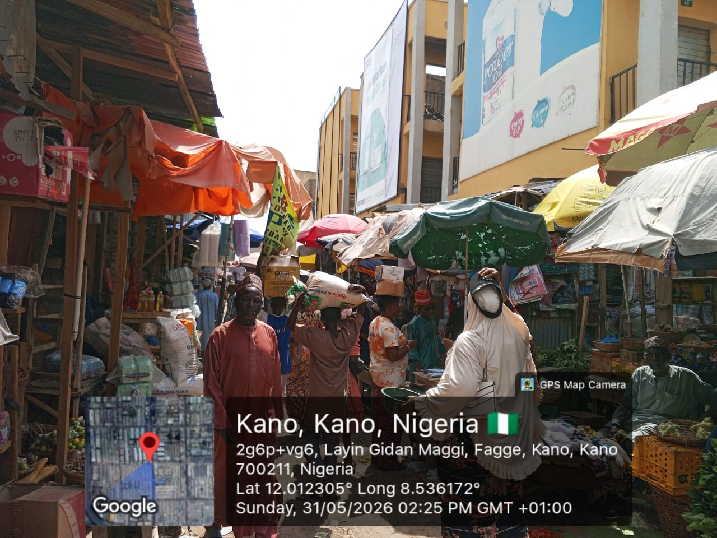
WALL DRAPE
www.outreachmedialtd.net| i n f o @ outreachmedialtd.net| 08092222091; 08037865256

Slide 29
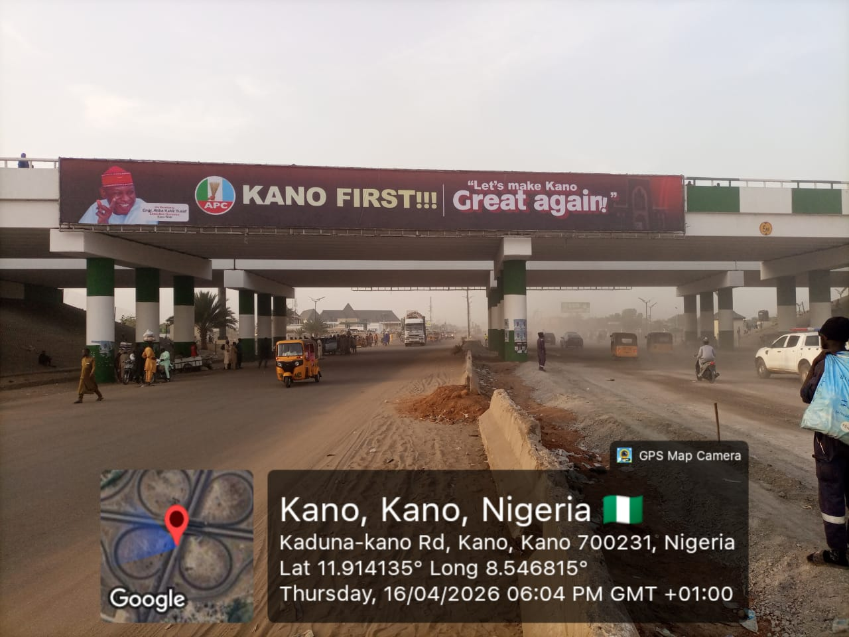
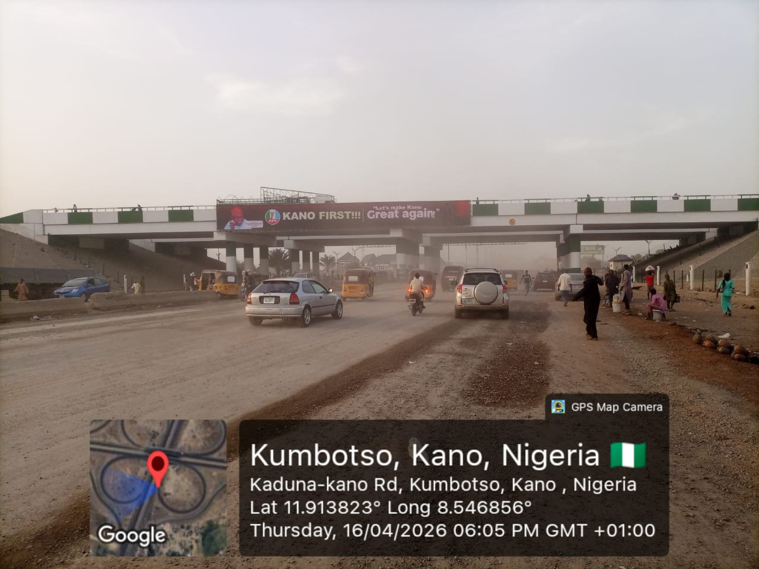
BRIDGE PANEL
www.outreachmedialtd.net| i n f o @ outreachmedialtd.net| 08092222091; 08037865256

Slide 30
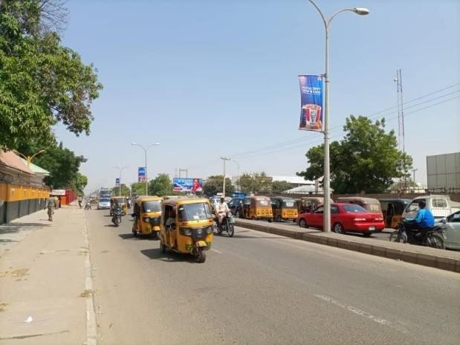
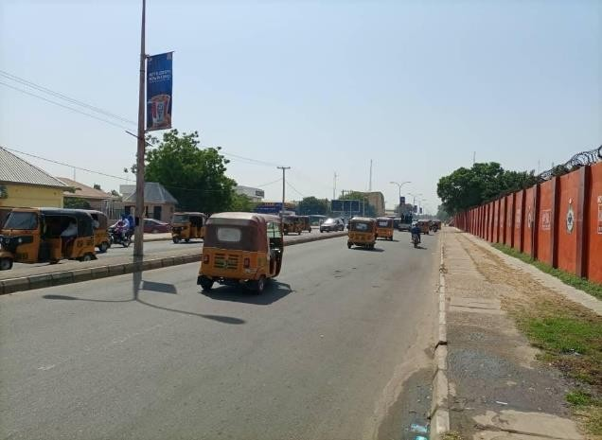
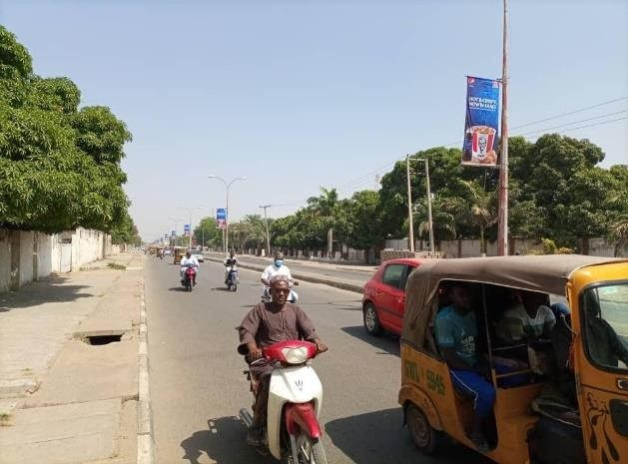
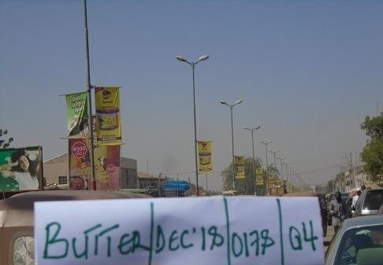
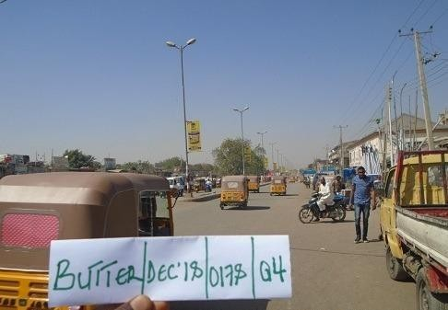
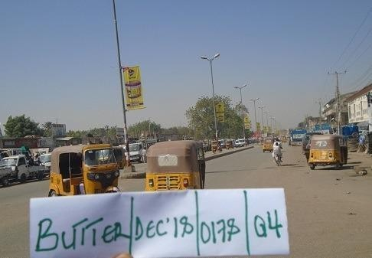
LAMPOLES
www.outreachmedialtd.net| i n f o @ outreachmedialtd.net| 08092222091; 08037865256

Slide 31
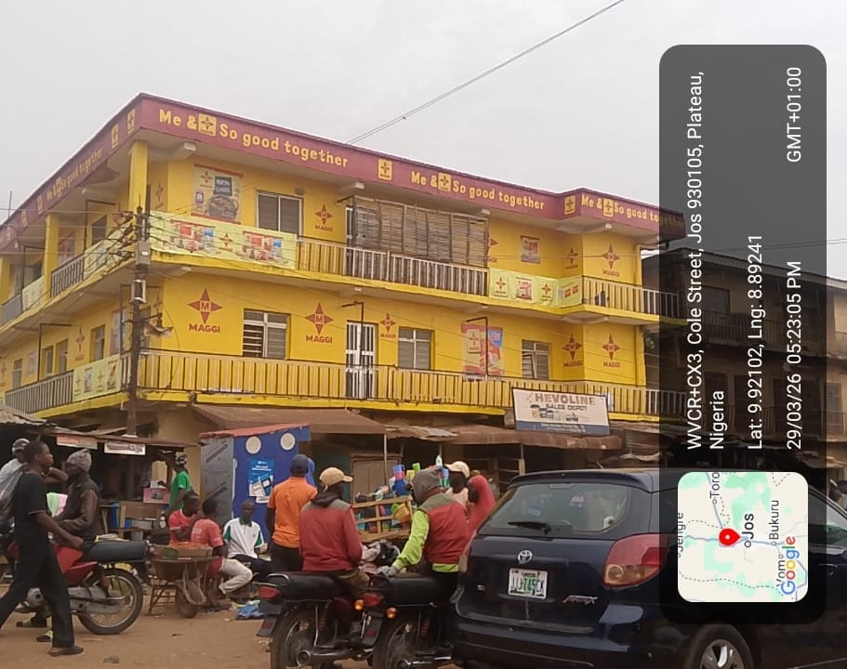
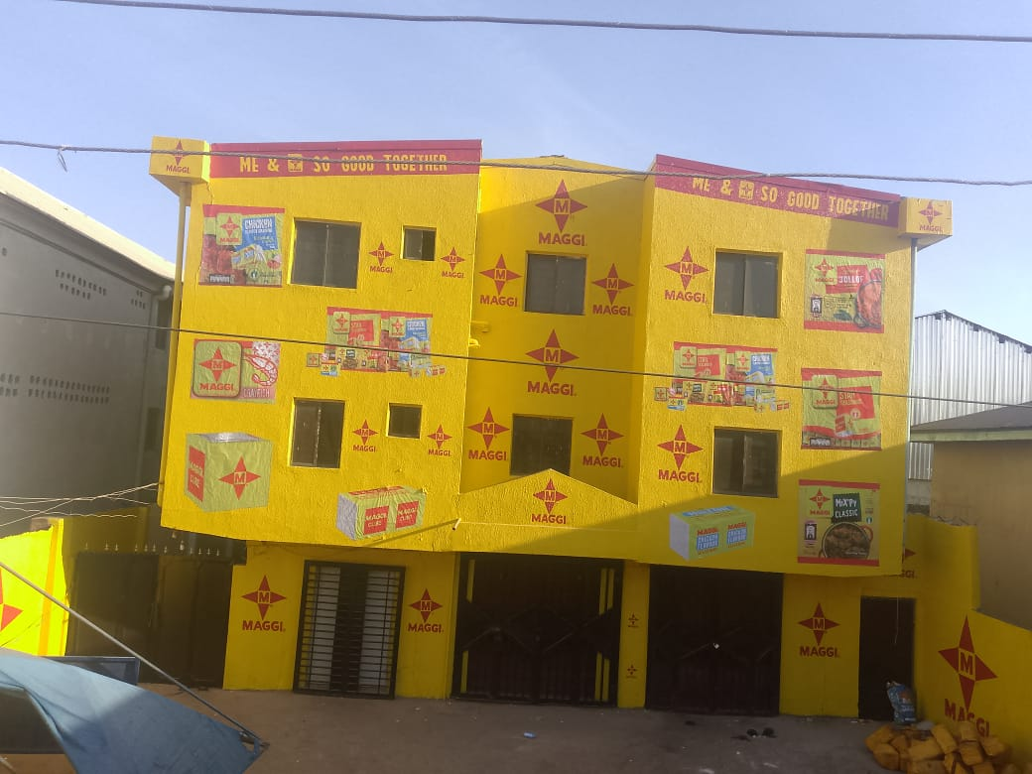
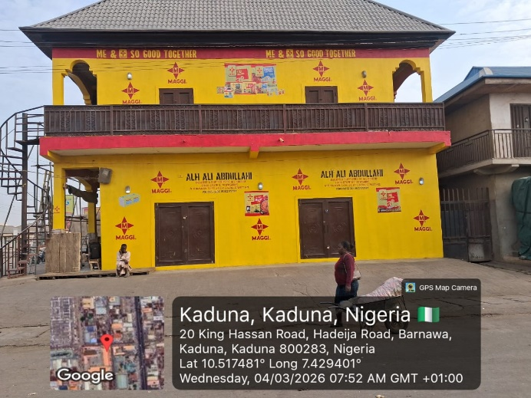
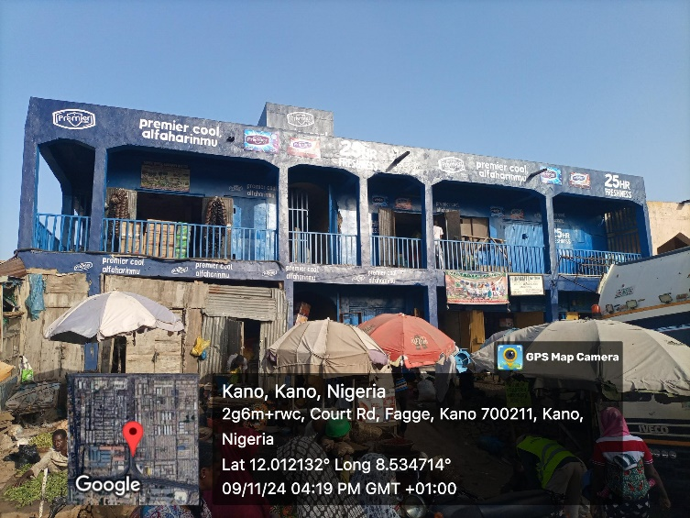
BUILDING BRANDING

Slide 32







OUR CLIENT

Slide 33
Thank you

